Slide 1
SCOPE VALIDATION BRAD ELDRIDGE, KYTC
“The farther back you can look, the farther forward you are likely to see.”
-Winston Churchill
Notes:
What is Scope Validation??-check point to verify what the project is suppose to accomplish. It is not necessarily alternates or a solution (scope of possible impacts). If this problem is fixed then the project is successful.
When????Providing some guidance to help bridge the gap between Planning and Preliminary Design. Overview-HDM 202 Pre-Design Activities and touch on key activities
Hopefully helpful to kick start a project and consultants may use this information/guidance when preparing proposals

Slide 2
Project Scoping
Involves getting information to start a project, and identifying the features the product would have in order to meet its stakeholder’s requirements.
A series of project-focused activities that develop key design parameters and other project requirements.
Notes:
Product Scope:: The features and functions that characterize a product (define product), service, or result. (Functional requirements or Project What’s)
Project Scope: More of the Pre-Design Meeting with Consultants. The work tasks that needs to be accomplished to deliver a product, service, or result with the specified features and functions. (Scope of Work OR Project How’s)
Scope in Project Management: The process of obtaining information required to commence a particular project and using such information to create a detailed description of the project and product. It also involves knowing about the features of the product that will meet the requirements of the stakeholder. (Have knowledge of possible scope of impacts)
PROCESS OR SERIES OF ACTIVITIES INCLUDING GETTING INFORMATION TO DEVELOP DETAILED DESCRIPTION OF PROJECT AND PRODUCT
INDENTIFYING THE FEATURES TO MEET STAKEHOLDERS REQUIREMENTS…..WHO ARE STAKEHOLDERS?-sponsor, travelling public, locals, maintenance?, construction?, etc.

Slide 3
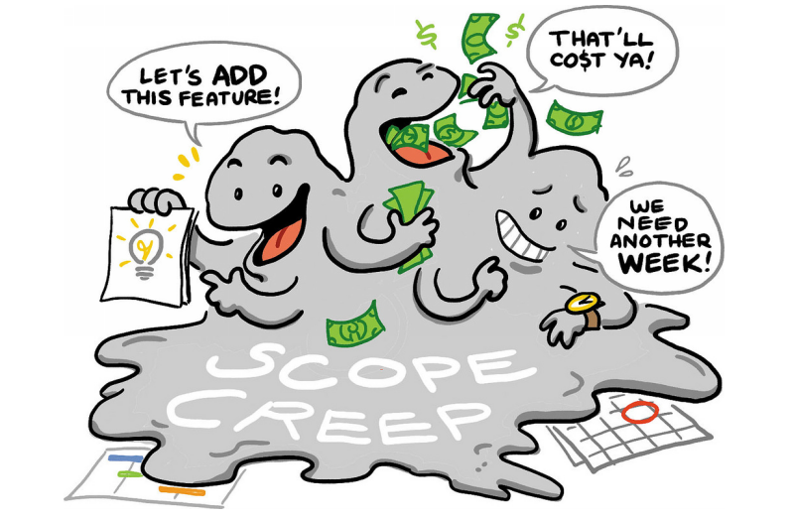
Pitfall of Inadequate Scope
Over come negative impact of scope creep and scope changes
Notes:
Cause may be getting started too quick.
-Not sure of impacts
-No Defined limits of project to accomplish task
-No baseline costs
-No risk analysis or contingencies established. Meaning, estimates may vary according risk, size of project/possible solutions, etc. Recognize/state this or get more information via planning study etc. Need to allocate proper amount of time for size and complexity of each project. (Flexibility) May consider a Planning Study is needed first (D-7, US 27)
P&N help to hold/deign projects limits as well.
Also, may have tendency to increase scope to improve facility performance without adequately considering additional impacts on R,U, or E. For example, if we could just extend to that intersection or if we could just fix that next curve, etc…..

Slide 4
Benefits of Project Scoping
Statistical Evidence indicates that earlier and more detailed scoping efforts can reduce total design and construction cost by as much as 20% and shorten total design and construction schedule by as much as 39%. (NCHRP Report 821- Effective Project Scoping)
Notes:
BENEFIT-KTC Research. Granted Scoping as defined through preliminary engineering.
Also:
-Improve interaction between project disciplines based on a team approach
-Improve relationship with external stakeholders
-Improve on-time and on-budget project delivery (predictability)
-Provide a consistent and reliable approach. (D-10 has used a scoping agenda).
In addition, there is a cost to delaying delivery of projects. Former State Highway Engineer mentioned time to let is now. For every $ invested generates $5-7 returned. Better return than money market or savings account ☺

Slide 5
Steps to Validating Scope
Scope
PROJECT INITIATION
Data Gathering
Resource Determination
Purpose
Specific Data of Needs
Sched. & Est.
Project Data Gathering
Pre-Design Meeting
Draft P&N
Project Scope
Notes:
MEAT OF PRESENTATION
Official New HDM signed and approved 3/27/17. HD-202 Pre-Design Activities.
Going to focus on some main points in this area.
Parallel graphic representative to show how it builds upon itself. Note that an estimate is determined that should align with budget. (Nice if preliminary engineering and environmental were a program so an estimate could support the budge).
EXERCISE: WHAT TYPES OF EXISTING DATA MAY BE USEFUL DURING THIS PROCESS, INCLUDING SPECIFIC DATA BASED ON PROJECT “NEEDS” PER P&N…. Ask the audience. Flip charts

Slide 6
Project Data
Highway Information View & Extract Interface, HIVEi
Planning Studies/DNA
As-built/Record Plans
Traffic data
Crash data
Project Mapping
Right of Way
Preliminary Budget
Existing Geotechnical Information
Utilities
Agency Coordination
Modal Considerations
Notes:
Cheated to get more information from audience ☺
Here is HD-202 and many include links.
Plug for GIS Presentation on surfacing existing data.
May talk on slide, flipchart, & these:
HIVEi very helpful
DNA’s
Crash Data
Magnitude of right of way-possible impacts, constraints, risks, rates, contingencies on estimate, etc.
*Agency coordination-information from planning engineer. Known activities or future activities in the areas. Would also consider sponsor.
Continuous Highway Analysis Framework, CHAF. Used to be PIF or Project Information Form (unscheduled needs project list)

Slide 7
Pre-Design Meeting
Draft Purpose and Need
Project Scope
Schedule and Milestones
Additional Resources
Additional Mapping
Environmental Overview
Traffic Forecasting
Public Involvement
Notes:
Still in Pre-Design Activities move into Pre-Design (D-10) meeting which is NOT the Pre-design Conference with the consultant!!! Conference meeting helps identify tasks and schedule for the consultant to perform.
Focus on Draft Purpose and Need and obviously Project Scope. P&N not final until NEPA Approval or DES for non-Federal projects. P&N and Scope are Information sharing to better understand project needs, deliverables, and constraints.
Would add to public involvement internal/external participants, locals, and stakeholders. Remember to include maintenance and construction.
These groups can help further define needs, potential project outcomes and identify risks associated with the project.
May consider meeting at maintenance barn with site visit and/or using Google Earth.

Slide 8
Purpose and Need Statement
Is the first decision point of the shared decision process.
Provides the foundation and framework for determining which alternatives will be considered and for selecting the preferred alternative.
Contains factual and objective data and information on the statement of the current conditions and why the project is being pursued.
Notes:
Besides the bullets:
Necessary for developing all projects.
Explains to the public and decision-makers that the expenditures of funds is necessary and worthwhile.
With SHIFT and performance based design process is data driven so a well thought out and constructed P&N is essential. For performance measures may lean on resources like Highway Capacity Manual, Highway Safety Manual etc…..REMEMBER THAT THE P&N IS NOT THE SOLUTION. IDENTIFY SPECIFIC NEEDS AND DEVELOP A FLEXIBLE PURPOSE TO INCAPSULATE A REASONONABLE AND COMPETTIVE RANGE OF ALTERNATIVES
Sources and development of P&N……..CHAF (formerly PIF) -TO- DNA/Planning Study –TO- Pre-Design Meeting
At Pre-design stage need a well thought out P&N. How you start can really have an impact on how you will finish.

Slide 9
Purpose and Need Handbook
Notes:
Re-emphasize importance of P&N
Plug for P&N training. Pilot held August 14th at Engineering Center by Jeff Moore. Consisted of planning, design, and env. Based on KYTC and AASHTO practices. Next class end of year.

Slide 10
Developing a Project Scope
Type of Project
Project Description
Draft Purpose and Need
Roadway Characteristics
Potential Options to Consider
Utility Requirements
Design Criteria
Proposed Access Control
Possible Funding Types
Potential Environmental Actions
Right of Way Requirements
Number of Drainage Structures Anticipated
Notes:
Second bullet, Project Scope, in the Pre-Design Meeting and guidance to help validate the scope.
Type of project-scalability of project. New construction, Reconstruction, Rehabilitation, Restoration etc. Projects may have an alternative that is more of a maintenance applications especially if it is meeting the P&N while optimizing the b/c.
From project scoping need to establish the draft P&N which may be different from previous. Again a draft at this point.
Type of project may also influence type guidance-Capacity/HCM or Access Management, Safety/HSM, Rural or Local/Low Volume Guide, 3R/TRB Special Report 214, and New alignment/Green Book,
Plug for Green Book presentation and how evolving to Performance Base Design, more multimodal, and future 3R flexibility vs. nominal/standard.
Potential Environmental Actions-from env overview and magnitude of right of way impacts have an idea on level of env document-CE I-III, FONSI, EIS. FHWA requires a Scope Verification per HD-202.6.6. Also look at items like project limits established.

Slide 11
Results of Scope Validation
Draft purpose and need
General concept of what project should accomplish (and will not)
Potential impacts and associated risks
Baseline scope of work, cost, and schedule
Notes:
(Read slide)
Purpose and Need is needed for advertisement. Need to communicate to consultants was is expected to be delivered and what is not. Set project limits.
Ready to advertise.

Slide 12
“BY FAILING TO PREPARE, YOU ARE PREPARING TO FAIL.”
-BENJAMIN FRANKLIN
Notes:
With better scoping & validation can help keep projects on-time and within budget.

Slide 13
Thank You
Notes:
Contact me @ (502) 564-3280 or Brad.Eldridge@ky.gov

